Slide 1
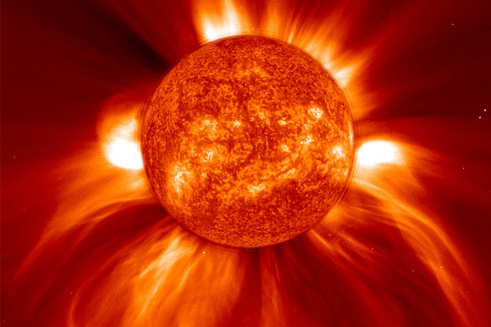
The Sun

Slide 2
Of medium size by star standards, it is composed mainly of hydrogen (73 percent by mass) and helium (25 percent by mass)

Slide 3
The rest is made up of heavier elements including carbon, oxygen, and iron

Slide 4
THE SUN’S LAYERS

Slide 5
THE CORE
- pressures are high and temperatures are at least 15 million degrees Celcius.
- Nuclear fusion happens in the Sun’s core
- Nuclear fusion is a process in which light atoms fuse (meaning combine) and become heavier ones. - During fusion, a small amount of matter is turned into a huge amount of pure energy.

Slide 6
Radiative Zone Convective Zone
The plasma is very dense here. Light and other forms of radiation are continuously absorbed and re-emitted in all directions.
The layer outside the radiative zone is the convective zone. In this region, huge bubbles of hot plasma ooze up toward the surface, carrying energy.

Slide 7
Photosphere, Chromosphere, and Corona

Slide 8
PHOTOSPHERE
Photosphere is usually considered to be the boundary between the inside and the outside of the Sun. This is the part of the Sun we see from Earth.

Slide 9
CHROMOSPHERE
“Chromos” means coloured, and this layer has a red cast to it.
Because the yellow photosphere is so bright, however, we can see the chromosphere only during a total solar eclipse

Slide 10
CORONA
The outermost layer of the Sun and extends beyond the chromosphere for millions of kilometres.

Slide 11
SUN’S MAGNETIC FIELD

Slide 12
Magnetic Field
A magnetic field, generated by movement of the plasma deep in the Sun’s interior
The Sun’s magnetic field extends far out into space where it is carried by the solar wind.
It is extremely powerful and can be seen in the way the Sun’s plasma reacts.

Slide 13
SUN SPOTS

Slide 14
SUN SPOTS
A region on the Sun’s surface that is cooler than the surrounding areas. Although still very bright, by contrast it looks darker than the surrounding areas.
Sunspots indicate regions where the magnetic field is extremely strong

Slide 16
Prominence
Is a large, often curved, bright stream of particles extending outward from the photosphere into the corona.

Slide 17
SOLAR FLARE
Is a massive explosion at the surface of the Sun.
It usually originates where the magnetic field breaks out of the Sun’s surface and interacts with the chromosphere and corona.
This sudden release of magnetic energy flings hot plasma out into space, which we see as a long bright filament extending out from the Sun.

Slide 18
CORONAL MASS EJECTION
An extremely powerful kind of flare
A large amount of plasma is thrown out through the corona and into space at a speed of more than 1000 km/s
When reaches Earth about three days later, it meets Earth’s magnetic field
Our magnetic field protects Earth by diverting much of the plasma away from the planet’s surface
This causes particularly vivid and active auroras

Slide 19
SOLAR WIND

Slide 20
SOLAR WIND
Constant flow of HEAT particles, streaming out of the Sun’s surface in all directions

Slide 21
WHAT IS THIS?

Slide 22
Aurora Borealis
Solar wind is responsible for creating displays of green, yellow, and red light in the skies near Earth’s northern and southern regions
In the northern hemisphere, these light displays are called the aurora borealis (the Northern Lights)
In the southern hemisphere, they are called the aurora australis (the Southern Lights).

Slide 23
http://www.youtube.com/watch?v=DU4hpsistDk&feature=relmfu
http://www.youtube.com/watch?v=DEoT_EH_Uss&feature=related
http://www.youtube.com/watch?v=wFb7OZx2NYo

